Slide 1
INTRODUCTION TO CYBER SECURITY
(Module 1)

Slide 2
What is Cyber Security
Cyber security refers to a set of techniques used to protect computers, networks, programs, devices and data from attacks, damage and unauthorized access.
Effective cyber security reduces the risk of cyber attacks and protects against the unauthorized exploitation of systems, networks and technologies.
It includes two terms: cyber and security
Cyber includes: including everything related to computers
Security means protecting cyber from attacks.

Slide 3
Abstract
Different types of cyber security
Network security is the practice of securing a computer network from intruders, whether targeted attackers or opportunistic malware.
Application security is the process of developing, adding, and testing security features within applications to prevent security vulnerabilities against threats such as unauthorized access and modification.
Information security protects the integrity and privacy of data, both in storage and in transit.
Operational security is a security and risk management process that prevents sensitive information from getting into the wrong hands
Cloud security is concerned with securing data, applications, and infrastructure in the Cloud.

Slide 4
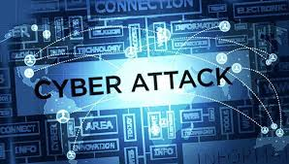
Abstract
What is Cyber Attack
A cyber attack is an attack launched from one or more computers against another computer, multiple computers or networks.
It is an attempt by hackers to damage or destroy a computer network or system.
Those who perform cyber attacks or cyber crime are called cyber criminals.

Slide 5
Abstract
Most Common Cyber Attack
Malware
Phishing
Man-in-the-middle attack
Denial-of-service attack
SQL injection
Zero-day attack

Slide 6
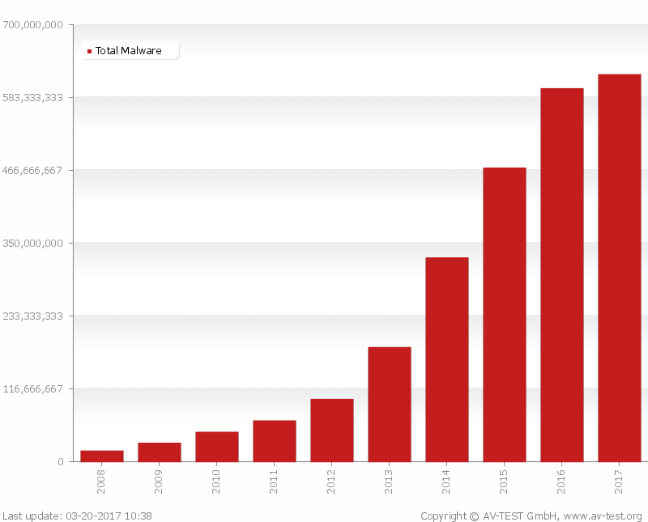
Abstract
Malware
MALWARE is
Malicious Software.
Adware, Spyware,Virus,Worm, Ransomware
Malware can do
allow cybercriminals to get into other people’s computers without their permission
steal personal information
delete files
steal software serial numbers
According to AV-Test in March 2017,the total number of malwares is increasing exponentially since 2008.
Due to such increasing ,it is necessary to detect these files before they harm

Slide 7
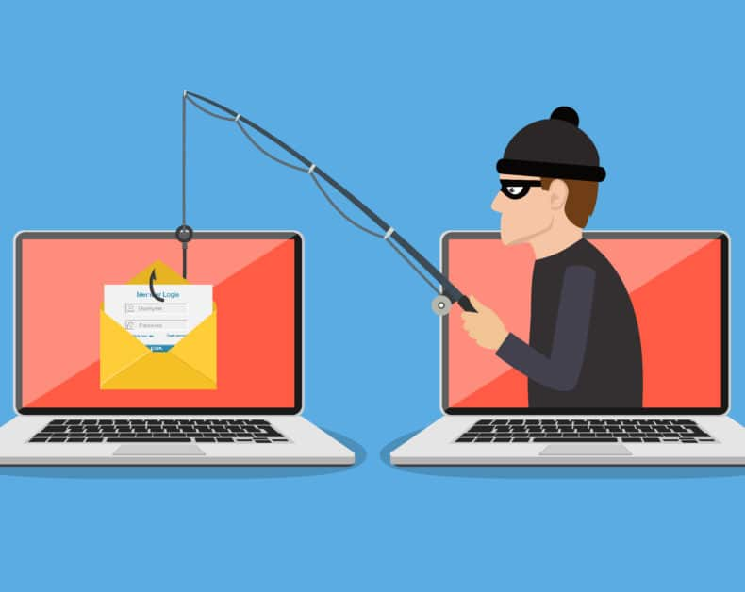
Phishing
In a phishing attack, an attacker may send you an email that appears to be from someone you trust, like your boss or a company you do business with. The email will seem legitimate, and it will have some urgency to it (e.g. fraudulent activity has been detected on your account). In the email, there will be an attachment to open or a link to click. Upon opening the malicious attachment, you’ll thereby install malware in your computer. If you click the link, it may send you to a legitimate-looking website that asks for you to log in to access an important file—except the website is actually a trap used to capture your credentials when you try to log in.

Slide 8
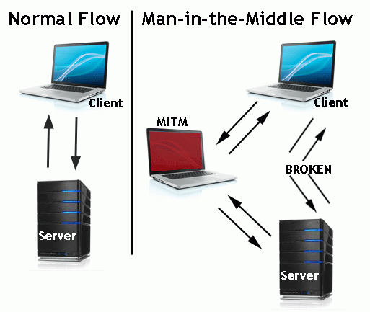
Man-in-the-middle Attack
A man-in-the-middle attack is a type of cyberattack where a malicious actor inserts him/herself into a conversation between two parties, impersonates both parties and gains access to information that the two parties were trying to send to each other. A man-in-the-middle attack allows a malicious actor to intercept, send and receive data meant for someone else, or not meant to be sent at all, without either outside party knowing until it is too late.

Slide 9
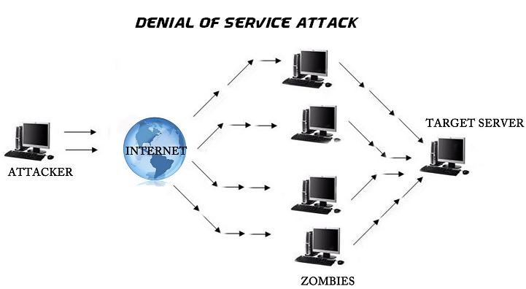
Denial-of-service Attack
A Denial of Service (DoS) attack, consists of sending a large amount of internet traffic towards a server which hosts a website to stop somebody or anybody from accessing it.
As a result, the server is unable to fulfill legitimate requests.
A distributed denial of service (DDoS) attack uses an army of computers, usually compromised by malware and under the control of cybercriminals, to funnel the traffic towards the targets.

Slide 10
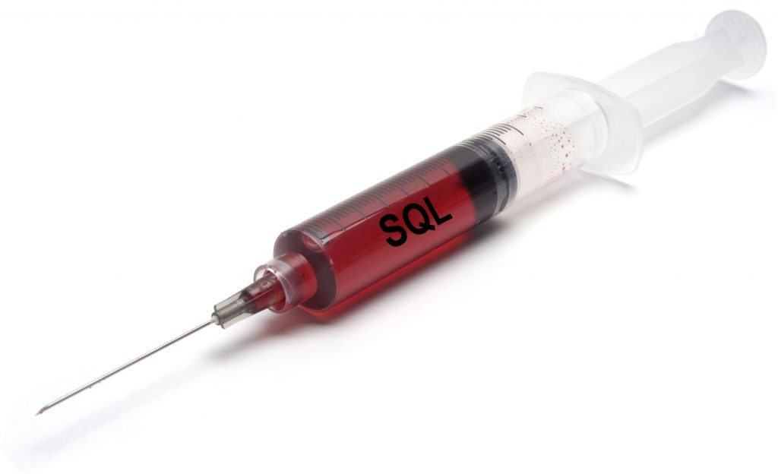
SQL Injection Attack
SQL (pronounced “sequel”) stands for structured query language; it’s a programming language used to communicate with databases.
Many databases are designed to obey commands written in the Structured Query Language (SQL), and many websites that take information from users send that data to SQL databases.
An attacker wishing to execute SQL injection manipulates a standard SQL query and forces the server that stores the database to reveal or manipulate information it normally would not.

Slide 11

Abstract
Cyber crime
Cyber crime is an activity done using computers and internet. We can say that it is an unlawful acts wherein the computer either a tool or target or both.

Slide 12
Abstract
Categories of Cyber crime
We can categorize cyber crime in two ways.
The computer as a target :- using a computer to attacks other computer, e.g. Hacking, virus/worms attacks, Dos attack etc.
The computer as a weapon :- using a computer to commit real world crime e.g. cyber terrorism, credit card fraud etc.

Slide 13
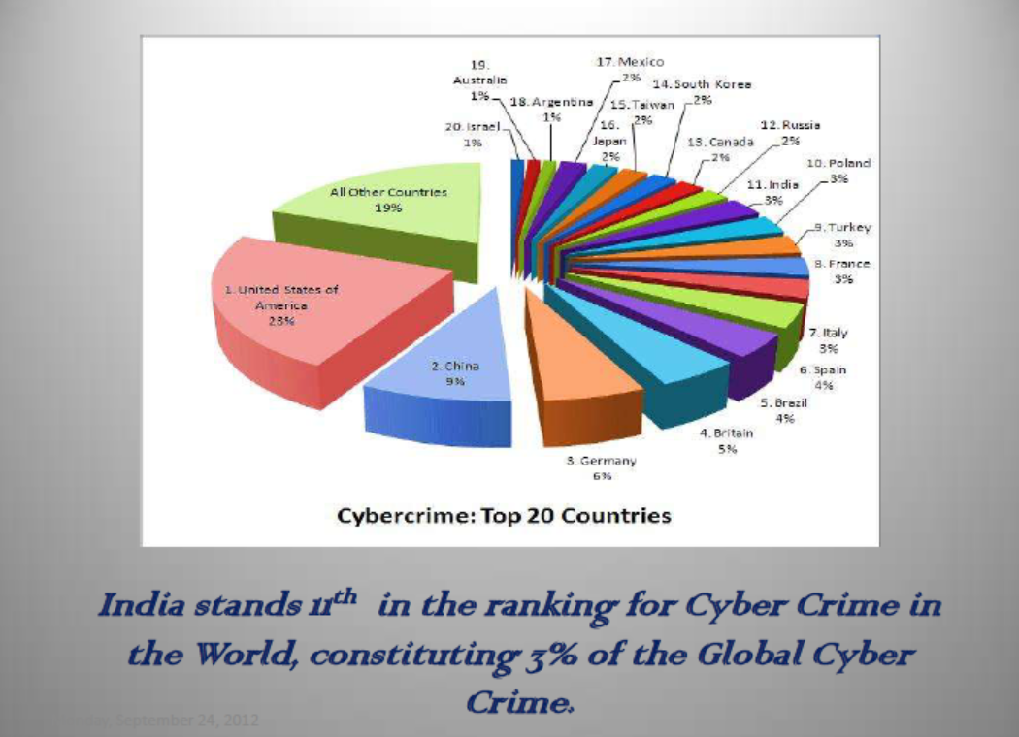
Abstract
Cyber crime statistics in India
In India
121 Million Internet Users
65 Million Active Internet Users,
50 Million users shop online on Ecommerce and Online Shopping Sites
46+ Million Social Network Users
346 million mobile users had subscribed to Data Packages.

Slide 14
Abstract
Cyber crime statistics in India
The majority of cybercrimes are centered on forgery, fraud and Phishing.
India is the third-most targeted country for Phishing attacks after the US and the UK,
Social networks as well as ecommerce sites are major targets,
15,000 sites hacked in 2011,
India is the number 1 country in the world for generating spam
29.9 million people fell victim to cybercrime,
$4 billion in direct financial losses,
$3.6 billion in time spent resolving the crime,
4 in 5 online adults (80%) have been a victim of Cybercrime,
17% of adults online have experienced cybercrime on their mobile phone.
The police have recorded 3,038 cases but made only 2,700 arrests in 3 years (between 2007 and 2010)
India registered only 1,350 cases under the IT Act and IPC in 2010
50% of cybercrimes are not even reported.

Slide 15
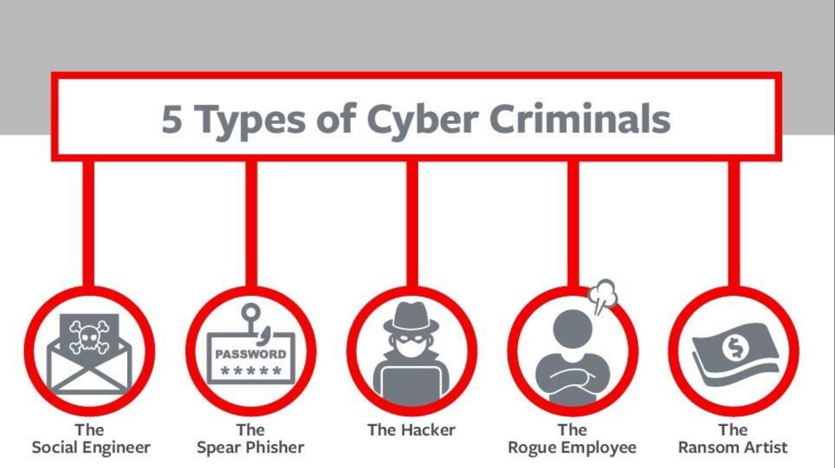

Slide 16
Social Engineer
Social engineering is the art of manipulating people so they give up confidential information. The types of information these criminals are seeking can vary, but when individuals are targeted the criminals are usually trying to trick you into giving them your passwords or bank information, or access your computer to secretly install malicious software–that will give them access to your passwords and bank information as well as giving them control over your computer.

Slide 17
Spear-Phisher
Spear-phishing is a type of phishing attack that targets specific individuals or organizations typically through malicious emails. The goal of spear phishing is to steal sensitive information such as login credentials or infect the targets' device with malware.

Slide 18
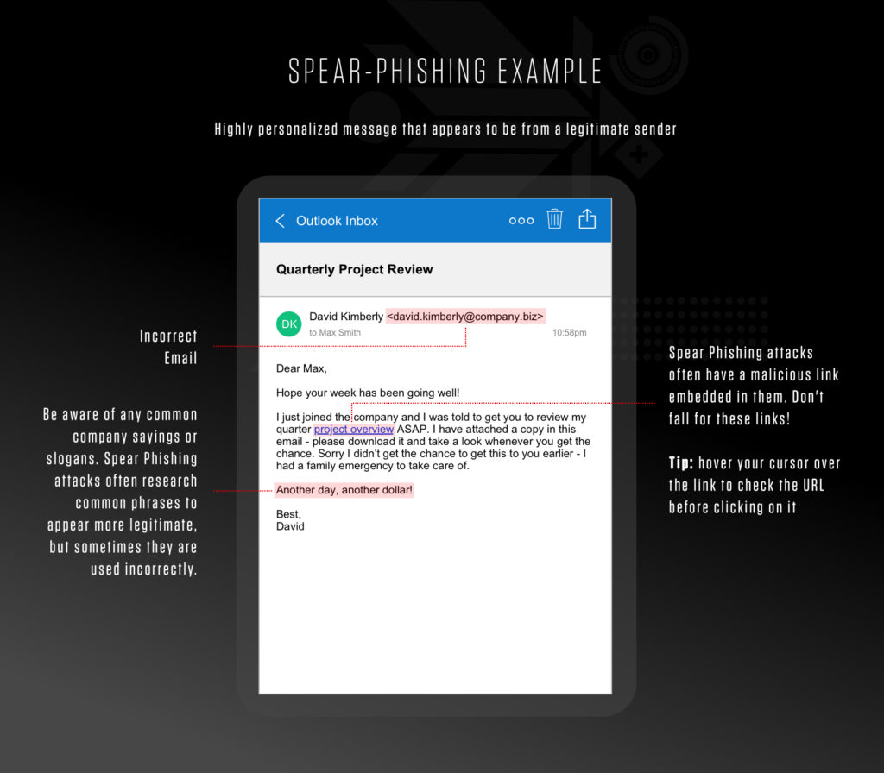

Slide 19
Rouge Employee
A rogue employee is a worker who undermines the organization in which he works by failing to follow its business rules and policies.
Their actions might be relatively harmless or serious enough to pose a risk to the security of your data. In the worst-case scenario, a rogue employee will attempt to undermine your organization by giving your data to a competitor .

Slide 20
Ransom Artiest
Ransomware is a malware designed to deny a user or organization access to files on their computer. By encrypting these files and demanding a ransom payment for the decryption key, cyberattackers place organizations in a position where paying the ransom is the easiest and cheapest way to regain access to their file

Slide 21
Hacker
Hacking in simple terms means an illegal intrusion into a computer system and/or network . It is also known as CRACKING. Government websites are the hot target of the hackers due to the press coverage, it receives. Hackers enjoy the media coverage.
Financial theft, media coverage, pen testing
But not all hackers are bad

Slide 22
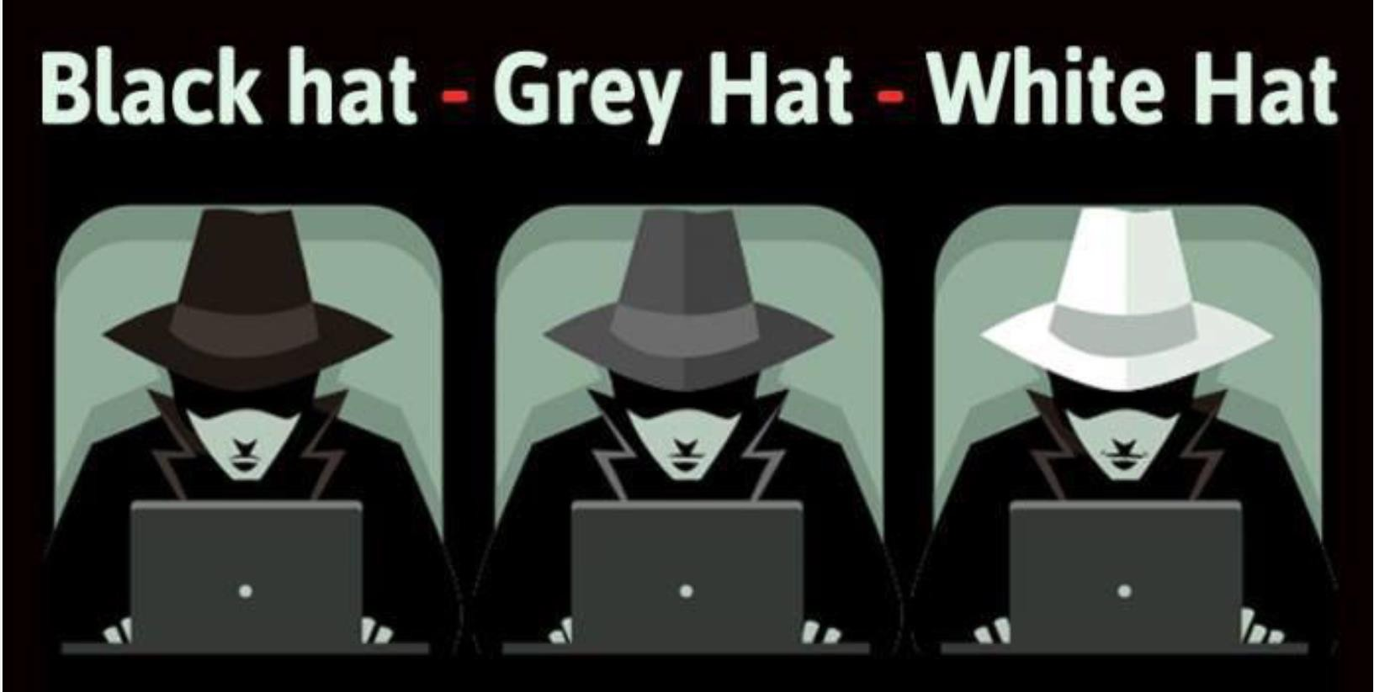
Types of Hacker
There are three types of Hackers
1. Black hat hacker
2. Grey hat hacker
3. White hat hacker
Which hat you want to wear?

Slide 23
Black hat Hacker
Black-Hat Hackers are those hackers who enter the system without taking owners’ permission. These hackers use vulnerabilities as entry points. They hack systems illegally.
They are the hackers who break into systems, steals passwords, credit card numbers, and other personal information and also releases malware that destroys files.
Black-hat hackers do this for financial gain (make money by selling data and credit card information on the dark web) and media coverage, revenge.
Some countries (China, Russia, and the USA) hires black hat hacker to steal data related to militaries from other countries.

Slide 24
White hat hacker
White-Hat Hackers are also known as Ethical Hackers or Good Hackers.
They are certified hackers who learn hacking from courses. These are good hackers who try to secure our data, websites.
These are hackers who are often employed by the government to protect their website, database, software against Black Hat Hacker.
Some ethical hackers work with organizations that find weaknesses in their software. They take permission from the system owners and use hacking techniques identical to black hat hackers, but they do so legally. They make people aware of cyber threats and ways to prevent them.

Slide 25
Grey hat Hacker
Gray-Hat Hackers are a mix of both black and white hat hackers. These types of hackers find vulnerabilities in systems without the owner's permission or knowledge.
If issues are found, they report them to the owner, sometimes requesting a small fee to fix the problem.
They don’t have any malicious intent. However, this type of hacking is still considered illegal. But they never share information with black hat hackers. They find issues and report the owner, sometimes requesting a small amount of money to fix it. These type of hackers does not put someone at risk.

Slide 26
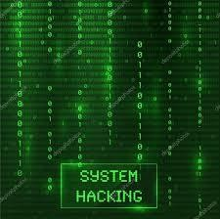
System Hacking
System hacking is a vast subject that consists of hacking the different software-based technological systems such as laptops, desktops, etc.
Here the malicious hacker exploits the weaknesses in a computer system or network to gain unauthorized access to its data or take illegal advantage.
Hackers generally use viruses, malware, Trojans, worms, phishing techniques, email spamming, social engineering, exploit operating system vulnerabilities, or port vulnerabilities to access any victim’s system.

Slide 27
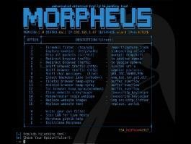
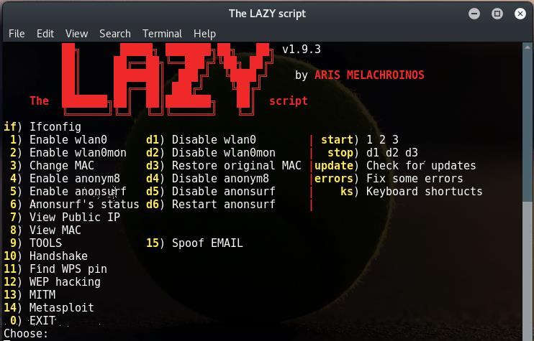
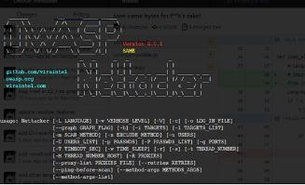
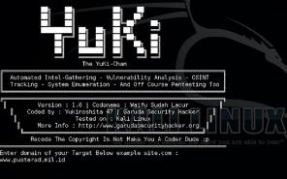
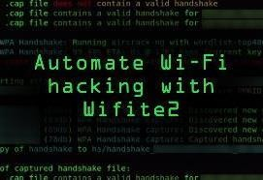
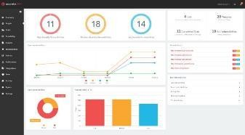
Attacks today are AUTOMATED!
It’s not some dude sitting at his hacker desk all day typing out ping commands to IP addresses via the command prompt manually…

Slide 28
What is Security?
Simple Definition: Achieving some objective(s) in the presence of an adversary
Computers are designed to work co-operatively
Browsers communicate with web (or cloud) servers
Devices communicate with each other (P2P)
Even isolated devices are rarely “isolated”
You plug in your flash drive in multiple systems!
You are potentially communicating with unknown entities
People or systems you don’t know and don’t trust
You have no idea how your information is being routed
Any of these people or systems could be an adversary

Slide 29
What is a Secure System? (CIA Triad)
Confidentiality – Preserving authorized restrictions on information access and disclosure
Integrity – protects against improper information modification or destruction
Availability – guarantee timely and reliable access to the information by authorized individuals.
Availability
These three concepts form what is often referred to as the CIA triad. The three concepts embody the fundamental security objectives for both data and for information and computing services

Slide 30
Example of CIA Triad
To have a better understanding of how the CIA Triad works in practice, consider an ATM that allows users to access bank balances and other information. An ATM incorporates measures to cover the principles of the triad:
The two-factor authentication (debit card with the PIN code) provides confidentiality before authorizing access to sensitive data.
The ATM and bank software ensure data integrity by maintaining all transfer and withdrawal records made via the ATM in the user’s bank accounting.
The ATM provides availability as it is for public use and is accessible at all times.

Slide 31
Levels of security breach impact
We use three levels of impact on organizations or individuals if there be a breach of security i.e., a loss of confidentiality, integrity, or availability).
Low: the loss will have a limited impact effect on organizational operations, organizational assets, or individuals.
If there will be a security breach (i.e., a loss of confidentiality, integrity, or availability), (i) result in minor damage to organizational assets; (ii) result in minor financial loss; or (iii) result in minor harm to individuals.
Moderate: the loss has a serious effect effect on organizational operations, organizational assets, or individuals.
(i) result in significant damage to organizational assets; (ii) result in significant financial loss; or (iii) result in significant harm to individuals that does not involve loss of life or serious, life-threatening injuries.
High: the loss has severe or catastrophic adverse effect on operations, organizational assets or on individuals (e.g., loss of life)
(i) result in major damage to organizational assets; (ii) result in major financial loss; or (iii) result in severe or catastrophic harm to individuals involving loss of life or serious life-threatening injuries.

Slide 32
Confidentiality
This term related two related concepts
Data confidentiality: Assures that private or confidential information is not made available or disclosed to unauthorized individuals
Confidentiality lost if criminal steals customers’ usernames, passwords, or credit card information.
To provide confidentiality, we are using encryption techniques
Enciphering an income tax return will prevent anyone from reading it. If the owner needs to see the return, it must be deciphered by entering a particular key
Privacy: Assures that individuals control or influence what information related to them may be collected and stored and by whom and to whom that information may be disclosed.
Example: Opening account in social media and bank account, we are sharing
Our personal information
A loss of confidentiality is the unauthorized disclosure of information

Slide 33
Confidentiality
Situation 1: Student grades within an Institute
Only accessed by the student and the employees who need that information to work (faculty handling the course, office staff etc.)
HIGH CONFIDENTIALITY
Situation 2: Student Enrollment Information
When the student joined, which courses he/she is taking etc.
Still confidential, but available to more people (all faculty, all office staff etc.)
MODERATE CONFIDENTIALITY
Situation 3: Student / Faculty/Department List at an Institute
Commonly available in public domain
Less likely to be of any issue if disclosed
LOW CONFIDENTIALITY

Slide 34
Integrity
Data integrity: Assures that information and programs are changed only in a specified and authorized manner
System integrity: Assures that a system performs its intended function in an unimpaired manner, free from deliberate or inadvertent unauthorized manipulation of the system
origin integrity: the source of the data (often called authentication)
Data Integrity is lost if Someone alters payroll information or a proposed product design.
Example: A newspaper may print information obtained from a leak at the White House but attribute it to the wrong source. The information is printed as received (preserving data integrity), but its source is incorrect (corrupting origin integrity).
A loss of integrity is the unauthorized modification or destruction of information.

Slide 35
Integrity
Situation 1: Patient Allergy Information
Doctors need to be sure the information is correct
If, knowingly or unknowingly, the information gets modified, it must be possible to identify the error and/or rectify it as soon as possible
Incorrect information could result in severe consequences
HIGH INTEGRITY
Situation 2: Web site that offers a online forum to registered users to discuss some specific .
If the information is overwhelmingly incorrect, the website owner will lose traffic
MEDIUM INTEGRITY
Situation 3: Anonymous Online polls
Everyone knows the polls are not trustworthy
LOW INTEGRITY

Slide 36
Availability
Example:
Your customers are unable to access your data or online services (Denial of Service Attacks)
Preventing disruption in how information is accessed
Systems, applications, and data will lose their value if they are not accessible by their authorized users whenever they require them. Availability is the accessibility of networks, systems, applications, and data by authorized users in a timely fashion whenever resources are required.
A loss of availability is the disruption of access to or use of information or an
information system.

Slide 37
Availability
Situation 1: Bank websites, authentication services
Financial transactions might be interrupted, heavy loss of revenue
HIGH AVAILABILITY
Situation 2: University websites
a site is not a critical component of the university’s information system, but its unavailability might cause loss of reputation
MEDIUM AVAILABILITY
Situation 3: Online telephone directory
Offline options available
LOW AVAILABILITY

Slide 38
Computer Security Terminology
Vulnerability refers to a weakness in your hardware, software, or procedures. (In other words, it's a way hackers could easily find their way into your system.) Can be detected by penetration testing
Threat exploits a vulnerability and can potentially harm an information system by disclosing the information stored on the system, adversely modifying data, or making the system unavailable
Risk: It’s the potential for loss, damage, or destruction of an asset when a threat takes advantage of a vulnerability. Put another way:
Threats + Vulnerability = Risk
A threat represents a potential security harm to an asset.
An attack is a threat that is carried out (threat action) and, if successful, leads to an undesirable violation of security, or threat consequence. The agent carrying out the attack is referred to as an attacker, or threat agent.

Slide 39
Computer Security Terminology
Adversary (threat agent):
An entity that attacks, or is a threat to, a system.
Countermeasure:
An action, device, procedure, or technique that reduces a threat, a vulnerability, or an attack by eliminating or preventing it, by minimizing the harm it can cause, or by discovering and reporting it so that corrective action can be taken.
Security Policy:
A set of rules and practices that specify or regulate how a system or organization provides security services to protect sensitive and critical system resources.
System Resource (Asset): Data contained in an information system; or a service provided by a system; or a system capability, such as processing power or communication bandwidth; or an item of system equipment (i.e., a system component— hardware, firmware, software, or documentation); or a facility that houses system operations and equipment.

Slide 40
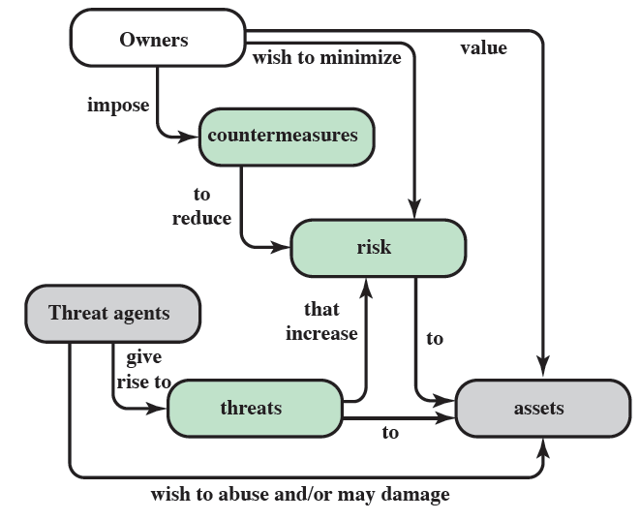
Security concepts and relationships

Slide 41
Threats and Attacks
Threats | Attacks
Unauthorized Disclosure: A circumstance or event whereby an entity gains access to data for which the entity is not authorized. It is threat of confidentiality | Exposure: Sensitive data released to an unauthorized entity. Ex: An insider intentionally releases sensitive information, such as credit card numbers, to an outsider Interception: An unauthorized entity accesses sensitive data in transit. It is a common attack in communication. Inference: An unauthorized entity indirectly accesses sensitive data by reasoning Ex: An example of inference is known as traffic analysis, in which an adversary is able to gain information from observing the pattern of traffic on a network, such as the amount of traffic between particular pairs of hosts on the network. Intrusion: An unauthorized entity gains access to sensitive data by circumventing a system’s security protections.

Slide 42
Threats and Attacks
Threats | Attacks
Deception: A circumstance or event that may result in an authorized entity receiving false data and believing it to be true. Deception is a threat to either system integrity or data integrity. | Masquerade: An unauthorized entity gains access to a system or performs a malicious act by posing as an authorized entity. Falsification: This refers to the altering or replacing of valid data or the introduction of false data into a file or database. For example, a student may alter his or her grades on a school database. Repudiation: In this case, a user either denies sending data or a user denies receiving or possessing the data.

Slide 43
Threats and Attacks
Threats | Attacks
Disruption: A circumstance or event that interrupts or prevents the correct operation of system services and functions. Disruption is a threat to availability or system integrity | Incapacitation: This is an attack on system availability. This could occur as a result of physical destruction of or damage to system hardware Corruption: Undesirably alters system operation by adversely modifying system functions or data. Obstruction: A threat action that interrupts delivery of system services by hindering system operation. One way to obstruct system operation is to interfere with communications by disabling communication links or altering communication control information.

Slide 44
Threats and Attacks
Threats | Attacks
Usurpation: A circumstance or event that results in control of system services or functions by an unauthorized entity. Usurpation is a threat to system integrity | Misappropriation: An entity assumes unauthorized logical or physical control of a system resource. An example is a distributed denial of service attack, when malicious software is installed on a number of hosts to be used as platforms to launch traffic at a target host. In this case, the malicious software makes unauthorized use of processor and operating system resources Misuse: Misuse can occur by means of either malicious logic or a hacker that has gained unauthorized access to a system. In either case, security functions can be disabled or thwarted.

Slide 45
Threats and Assets
Hardware: Including computer systems and other data processing, data storage, and data communications devices
Software: Including the operating system, system utilities, and applications.
Data: Including files and databases, as well as security-related data, such as password files.
Communication facilities and networks: Local and wide area network communication links, bridges, routers, and so on.

Slide 46
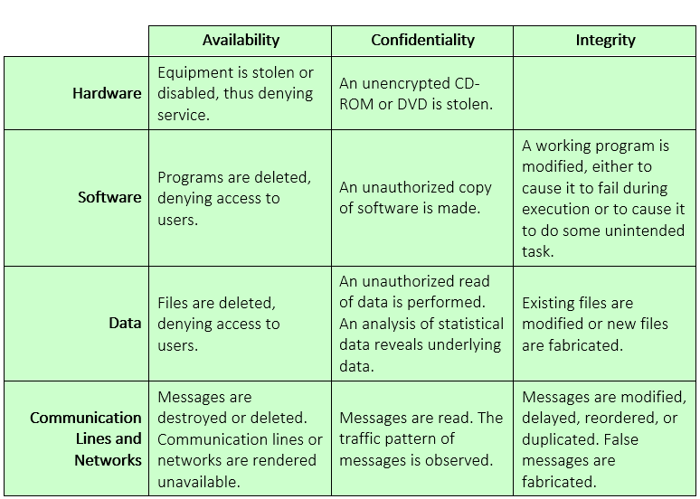
Threats and Asserts

Slide 47
Types of Attacks
We can distinguish two types of attacks:
Active attack: An attempt to alter system resources or affect their operation.
Passive attack: An attempt to learn or make use of information from the system that does not affect system resources.
We can also classify attacks based on the origin of the attack:
Inside attack: Initiated by an entity inside the security perimeter (an “ insider”). The insider is authorized to access system resources but uses them in a way not approved by those who granted the authorization.
• Outside attack: Initiated from outside the perimeter, by an unauthorized or
illegitimate user of the system (an “outsider”). On the Internet, potential
Outside attackers range from amateur pranksters to organized criminals, international terrorists, and hostile governments.

Slide 48
Passive Attack
Passive attack: In passive attack, the goal of the attacker is to obtain information that is being transmitted. Here the attacker can not modify the data
Two types of passive attacks are the release of message contents and traffic analysis.
Release of message contents: A telephone chat, an electronic mail message, and a transferred file can include sensitive or confidential data. It is like to avoid an opponent from understanding the contents of these transmissions.
Traffic Analysis: Even if we used encryption technique for masking the contents of the message, (even if they captured the message, could not extract the information from the message) an opponent might still be able to observe the pattern of these messages. The opponent could determine the location and identity of communicating hosts and could observe the frequency and length of messages being exchanged. This information might be useful in guessing the nature of the communication that was taking place.

Slide 49
Active Attack
Active attacks involve some modification of the data stream or the creation of a false stream and can be subdivided into four categories: replay, masquerade, modification of messages, and denial of service.
Replay involves the passive capture of a data unit and its subsequent retransmission to produce an unauthorized effect.
A masquerade takes place when one entity pretends to be a different entity.
Modification of messages simply means that some portion of a legitimate Message is altered, or that messages are delayed or reordered, to produce an unauthorized effect. For example, a message stating, “Allow John Smith to read confidential file accounts” is modified to say, “Allow Fred Brown to read confidential file accounts.”
The denial of service prevents or inhibits the normal use or management of communication facilities. This attack may have a specific target; for example, an entity may suppress all messages directed to a particular destination

Slide 50
Security Design Principles
The National Centers of Academic Excellence in Information Assurance/Cyber Defense, which is jointly sponsored by the U.S. National Security Agency and the U. S. Department of Homeland Security, list the following as fundamental design principles that can guide development of security mechanisms
• Economy of mechanism
• Fail-safe defaults
• Complete mediation
• Open design
• Separation of privilege
• Least privilege
• Least common mechanism
• Psychological acceptability
• Isolation
• Encapsulation
• Modularity

Slide 51
Security Design Principles
Economy of mechanism: the design of security mechanisms should be as simple as possible
Simple means not small
Simple systems are easier to understand, debug and maintain.
Simple systems have fewer vulnerabilities unlike complex systems.
Fail-safe defaults: Default action is to deny access
If action fails, system is as secure as when action began
Need to argue why a user should have a access do not argue why a user should not have access
Complete Mediation: Check EVERY access to EVERY object.
Sensitive web applications might require you to sign in every 15 minutes
If a program requests access to a file, the permissions must be checked every time the file is accessed, not only the first time

Slide 52
Security Design Principles
Open design: the design should be open rather than secret (e.g., encryption algorithms.
For example, although encryption keys must be secret, encryption algorithms should be open to public.
The algorithms can then be reviewed by many experts, and users can therefore have high confidence in them.
Separation of privilege : Check multiple conditions before giving access.
Banking websites check password and OTP. One check might fail, but it is highly unlikely that multiple checks would fail.
Multiple software modules, each requiring separate access is much secure than a monolithic system with a single access check.
Least privilege : Every process and every user of the system should operate using the least set of privileges necessary to perform the task.
For example, system programs or administrators who have special privileges should have those privileges only when necessary; when they are doing ordinary activities the privileges should be withdrawn.
There is no extension of privileges to senior people just because they are senior; if they don’t need the permissions to perform their normal everyday tasks, then they don’t receive higher privileges.

Slide 53
Security Design Principles
Least Common Mechanism: Mechanisms used to access resources should not be shared.
Sharing resources provides a channel along which information can be transmitted. Hence, sharing should be minimized as much as possible.
Psychological acceptability : Security mechanisms should not make the resource more difficult to access than if the security mechanism were not present.
If security mechanisms hinder the usability or accessibility of resources, users may opt to turn off those mechanisms.
Isolation: Isolation is a principle that applies in three contexts.
Public access should be isolated from critical resources (no connection between public and critical information)
Users files should be isolated from one another (except when desired)
Security mechanism should be isolated (i.e., preventing access to those mechanisms)

Slide 54
Security Design Principles
Encapsulation: It can be viewed as a specific form of isolation based on object oriented functionality.
Protection is provided by encapsulating a collection of procedures and data objects in a domain of its own so that the internal structure of a data object is accessible only to the procedures.
Modularity: Modularity in the context of security refers both to the development of security functions as separate, protected modules and the use of a modular architecture for mechanism design and implementation.
With respect to the use of separate security modules, the design goal here is to provide common security functions and services, such as cryptographic functions, as common modules. For example, numerous protocols and applications make use of cryptographic functions. Rather than implementing such functions in each protocol or application, a more secure design is provided by developing a common cryptographic module that can be invoked by numerous protocols and applications
Layering: Layered security refers to security systems that use multiple components to protect operations on multiple levels or layers. The layered approach to network security is based on theconcept of “defense in depth”.

Slide 55


Attack Surfaces
Which of the two buildings are more easy to break into?
The Plaza Hotel
The AT&T Long Lines Building (“Building with No Windows”)

Slide 56
Attack Surfaces
Attack surface consists a set of reachable and exploitable vulnerabilities through which an unauthorized user/attacker can gain unauthorized access to a system (or network or software) and extract data from it.
Examples of Attack Surfaces:- Examples of attack surfaces are the following:
Open ports
Services available on the inside of a firewall
Code that processes incoming data, email, XML, office documents
An employee with access to sensitive information vulnerable to a social engineering attack.

Slide 57
Attack Surface Classification
Attack surfaces can be categorized in the following way:
Network attack surface: This category refers to vulnerabilities over an enterprise network, wide-area network, or the Internet.
Software attack surface: This refers to vulnerabilities in application, utility, or operating system code. A particular focus in this category is Web server software.
Human attack surface: This category refers to vulnerabilities created by personnel or outsiders, such as social engineering, human error, and trusted insiders.

Slide 58
Attack Surface Reduction
One approach to improving security is to reduce the attack surface of a system or software.
Less code, less software attack surface (less code available to unauthorized actors, there tend to be fewer failures )
Remove unnecessary OS software and services
Scan your network ports
Segment your network
Audit your software, network and traffic

Slide 59
Attack Trees
Attack Trees: Attack tree provides a method to model the threats/attacks against a system in a graphical easy-to-understand manner. If we understand the ways in which a system can be attacked we can develop countermeasures to prevent those attacks achieving their goal. Attack trees are conceptual diagrams showing how an asset, or target, might be attacked. Attack trees are multi-leveled diagrams consisting of one root, leaves, and children. From the bottom up, child nodes are conditions which must be satisfied to make the direct parent node true; when the root is satisfied, the attack is complete. Each node may be satisfied only by its direct child nodes.
The security incident that is the goal of the attack is represented as the root node of the tree, and the ways that an attacker could reach that goal are iteratively and incrementally represented as branches and sub-nodes of the tree.
Each sub-node defines a sub-goal, and each sub-goal may have its own set of further sub-goals, etc.
The final nodes on the paths outward from the root, i.e., the leaf nodes, represent different ways to initiate an attack.

Slide 60
Attack Trees
Security analysts can use the attack tree to document security attacks in a structured form that reveals key vulnerabilities.
The attack tree can guide both the design of systems and applications, and the choice and strength of countermeasures.
An example of an attack tree analysis for an Internet banking authentication application. The root of the tree is the objective of the attacker, which is to compromise a user’s account. The analysis used to generate the following tree considered the three components involved in authentication.

Slide 61
Attack Trees
User terminal and user (UT/U): These attacks target the user equipment, such as smartcards, password generators, token generators as well as the actions of the user.
Communications channel (CC): This type of attack focuses on communication links.
Internet banking server (IBS): These types of attacks are offline attack against the servers that host the Internet banking application.

Slide 62
Attack Trees
Five overall attack strategies can be identified, each of which exploits one or more of the three components. The five strategies are as follows:
User credential compromise: This strategy can be used against many elements of the attack surface. There are procedural attacks, such as monitoring a user’s action to observe a PIN or other credential, or theft of the user’s token or handwritten notes. An adversary may also compromise token information using a variety of token attack tools, such as hacking the smartcard or using a brute force approach to guess the PIN.
Injection of commands: In this type of attack, the attacker is able to intercept communication between the UT and the IBS. Various schemes can be used to be able to impersonate the valid user and so gain access to the banking system.

Slide 63
Attack Trees
User credential guessing: It has been observed that brute force attacks against some banking authentication schemes are feasible by sending random usernames and passwords. The attack mechanism is based on distributed zombie personal computers, hosting automated programs for username- or password-based calculation.
Security policy violation: For example, violating the bank’s security policy in combination with weak access control and logging mechanisms, an employee may cause an internal security incident and expose a customer’s account.
Use of known authenticated session: This type of attack persuades or forces the user to connect to the IBS with a preset session ID. Once the user authenticates to the server, the attacker may utilize the known session ID to send packets to the IBS, spoofing the user’s identity.

Slide 64
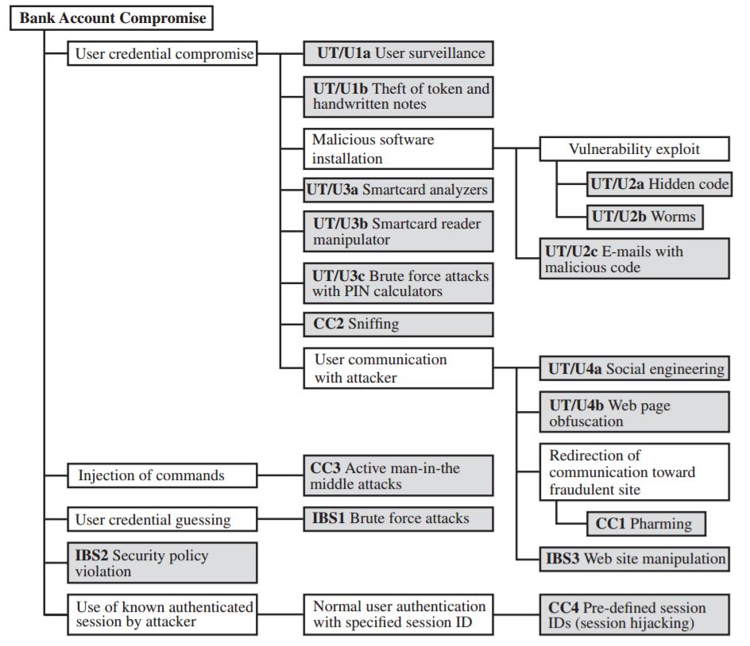
Example of Attack Trees

Slide 65
Computer security strategy
An overall strategy for providing security involves following aspects
Policy (specs): what security schemes are supposed to do?
Assets and their values
Potential threats
Ease of use vs security
Cost of security vs cost of failure/recovery
Implementation/mechanism: how to enforce
Prevention
Detection
Response
Recovery
Correctness/assurance: does it really work (validation/review)?

Slide 66
Security Policy
A security policy is a formal set of rules and practices that specify or govern how a system or organization provides security services to protect sensitive and critical system resources. In developing a security policy, a security manager needs to consider the following factors:
The value of the assets being protected
The vulnerabilities of the system
Potential threats and the likelihood of attacks
Further the manager must consider following tradeoff
Ease of use vs security: Almost all security measures have some cost in terms of usability.
Cost of security vs cost of failure/recovery:

Slide 67
Security Implementation/Mechanism
It involves how to enforce
Prevention: An ideal security scheme is one in which no attack is successful. Although this is not always feasible, there are many threats where prevention is a reasonable goal.
Detection: In some cases, absolute protection is not possible, but it is practical to detect security attacks.
Response: If security mechanisms detect an ongoing attack, such as a denial of service attack, the system may be able to respond in such a way that the attack must be stopped and further damage should be avoided.
Recovery: An example of recovery is the use of backup systems, so that if data integrity is compromised, a prior, correct copy of the data can be reloaded.

Slide 68
Assurance and Evaluation
It involves two things
Assurance: Assurance is expressed as a degree of confidence, not in terms of a formal proof that a design or implementation is correct. Thus, assurance deals with the questions, “Does the security system design meet its requirements?” and “Does the security system implementation meet its specifications?”
Evaluation is the process of examining a computer product or system with respect to certain criteria. Evaluation involves testing and may also involve formal analytic or mathematical techniques.

Slide 69


Slide 70
Introduction to Cyber Security
Module 2
Security Layers

Slide 71
Topics
Human factors in cyber security,
Perimeter Security
Network Security
Endpoint Security
Application Security
Data Security
Privacy.

Slide 72
Introduction
Increased frequency of high-profile breaches
Enormous pressure on IT departments
Improving confidence in one’s IT security requires
solid understanding of all potential vulnerabilities
Solid understanding of most effective best practices
Keeping your business protected against cyber attacks
A big challenge
However, risk can be minimized using Layered Security Approach

Slide 73
What is Layered Security?
According to Techopedia, layered security is defined as:
Layered security refers to security systems that use multiple components to protect operations on multiple levels or layers.
Individual layers in a multi-layered security approach
These layers work together to tighten security.
Purpose of the layered security approach:
Every individual defense component has a backup to counter any flaws or gaps in other defenses of security
Layered approach to network security is based on the concept of - Defense in Depth
Good idea to have several barriers
Attacker has to do a lot of work
Protective skin around the network
Each layer has its own set of protections and security controls.

Slide 74
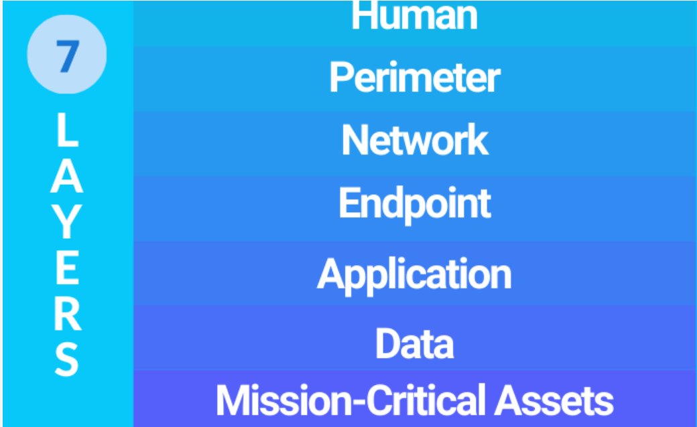
Seven Security Layers

Slide 75
Mission Critical Asserts
Anything your business can’t survive without.
Operating systems, electronic health records, software tools, financial records, and cloud infrastructure.
Assets you need to protect at any cost

Slide 76
Data Security
In almost every instance, data is the target
This layer requires the most attention
Customer data, payment information, Aadhar card numbers, business secrets (and other intellectual property), etc.
Losing this data
erodes your customers’ trust in your business,
huge regulatory fines,
about 50% of the time, causes your business to close.
Data security controls protect the storage and transfer of data
Different tools can be used
multifactor security,
authentication and encryption,
regular backups of all critical data

Slide 77
Application Security
Applications security controls protect access to an application,
an application’s access to your mission critical assets, and the internal security of the application.
Application layer revolves around the software we use in our business.
Microsoft Office, Slack, Zoom, antivirus, web server s/w, etc.
Issues with the outdated software:
Full of vulnerabilities, or security holes.
Can be overcome with patching
Process of distributing and applying updates to software and firmware.
This helps ensure that any known security problems are fixed and that the application is as secure as possible

Slide 78
End Point Security
Any device that is connected to your business network
Laptops, workstations, mobile devices, printers, scanners, copiers, security cameras, and more.
End devices are potential entry points for hackers.
Thus, they need to be included in your organization’s cybersecurity plan.
Tools and methods to achieve this security include:
Anti-virus and anti-malware applications.
Endpoint security measures and Host Intrusion Detection Systems
The removal of redundant or unused applications, services, and protocols.
Effective management of ports.

Slide 79
Network Security
Protects an organization’s network.
Prevent unauthorized access of the network.
This layer comprises the actual software and hardware dedicated to protecting the network in part or whole.
Protection here extends from
Enabling the on-board security features of routers and switches to the installation and configuration of firewalls, IPS, and IDS.

Slide 80
Perimeter Security
Outer layer of your network.
Subset of Network Security
Attempts to secure the perimeter of a network
E.g. Attacks coming from Internet to a local network
Does not deal with the insider attacks (e.g. ARP spoofing)
Also applicable to security of assets such as web server, mail server, etc. which are stored in DeMilitarized Zone (DMZ).

Slide 81
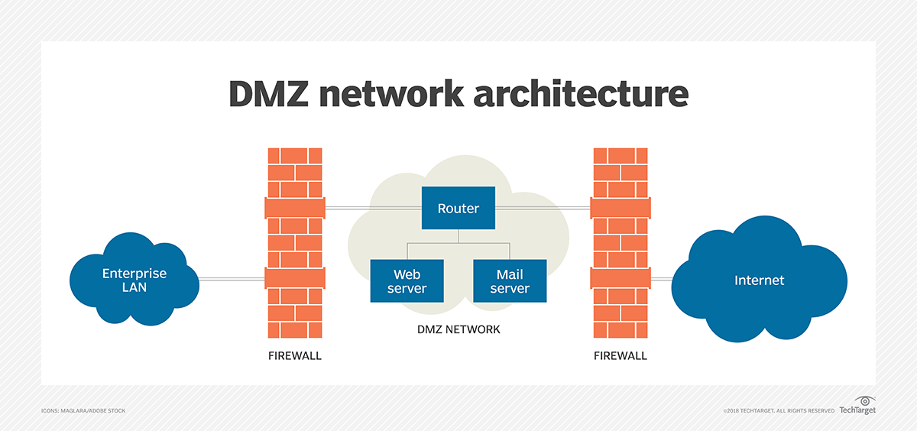

Slide 82
Human Layer
Humans are the weakest link in any cyber security chain.
According to reports, upwards of 90% of all security breaches are caused by humans.
Social engineering attack, insider attack
Best approach to keep this layer secure is education and training.
Training programs for good cyber security habits
This includes instruction on how to spot a phishing attempt, good password habits, and information on current scams to be on the lookout for.
Also instruct regular data backup
Access controls are also a good idea for securing the human layer since they can limit the amount of damage in case there is a successful attack

Slide 83
Layered Security as an Industry Best Practice
12 essential security best practices:
Firewall
First line of defense
Monitors the incoming and outgoing traffic
Only allows the traffic that is defined in the security policy
Patch Management
Mitigates issues with the outdated software
Addresses the functionality errors or bugs
Boosts performance
Multifactor Authentication
Requires multiple forms of verification to access an application, account, etc.
E.g. password followed by OTP
Endpoint protection
Web Content Filtering
Blocking users’ access to websites
Content can be blocked by specific categories also

Slide 84
Layered Security as an Industry Best Practice
12 essential security best practices:
Email Filtering
One of the most common cyberattack vectors
94% of the malwares are delivered by email
Only a single click on a malicious URL required to grant access to an entire network
Email filtering prevents phishing attacks, ransomware, viruses, malware, etc.
Security Awareness Training and Phishing simulations
What if an email slipped past your email filter?
Employees should be able to recognize phishing emails.
One-third of the reported data breaches involve phishing emails.
Training on cybersecurity basics and best practices is essential
Periodic phishing simulations
Sophisticated Password Policy
A strong ‘NO’ to duplicate passwords
One account breach may lead to breach of another account also
Policies for password strength and complexity (e.g., irregular capitalization and special characters)

Slide 85
Layered Security as an Industry Best Practice
12 essential security best practices:
Dark web monitoring
Home to many illegal activities
Sale of sensitive and personally-identifying information stolen
Employee credentials are best sellers on dark web. Why?
Dark web monitoring is the process of searching for, and tracking, your organization's information, including leaked or stolen data, compromised passwords, breached credentials, intellectual property, and other sensitive data
Physical Security
Firewalls can’t protect data from being copied and stolen via a USB drive.
That’s why physical layer security is important.
Restricts access to and protect your on-premises infrastructure and spaces in which data is stored.
Examples – keycards, door locks, security cameras, security personnel, etc.

Slide 86
Layered Security as an Industry Best Practice
12 essential security best practices:
Business Continuity and Disaster Recovery
In the event of a disaster such as a cyberattack, are you sure your data is protected?
Mitigate the downtime and damages due to attack
Continue the business even in the presence of the attack
Restore the data from backup
Two important reminders:
Isolate your backups to ensure that if your network is breached, your backups can’t also be accessed and encrypted
Ensure that your business continuity plan is documented, tested, and updated on a regular basis.
Managed Detection and Response (MDR)
How do you detect when someone or something has gotten past your other layers of protection?
Advanced security solution that combines next-generation monitoring software and a 24/7 (human-staffed) security operations center
to identify and isolate suspicious behavior on your network in real-time
If your preventative measures fail, MDR acts as the security camera that catches a cybercriminal sneaking onto your network and the alarm system that alerts you to the breach.
Without a detection and response tool:
it can take more than 200 days to discover a data breach,
Hackers get plenty of time to plan and execute a devastating attack before you are even aware of a problem.

Slide 87
The Essential Layers of IBM i Security
IBM i is an operating system developed by IBM for IBM Power Systems (i.e. Servers).
IBM i provides security through many layers.
These layers cover physical devices, networks, configuration of the IBM i OS, access to systems, protection of data at the file and field level, and monitoring and auditing of systems.
In other words, should one security layer be somehow compromised, there’s a good chance that another layer will thwart a would-be intruder.

Slide 88
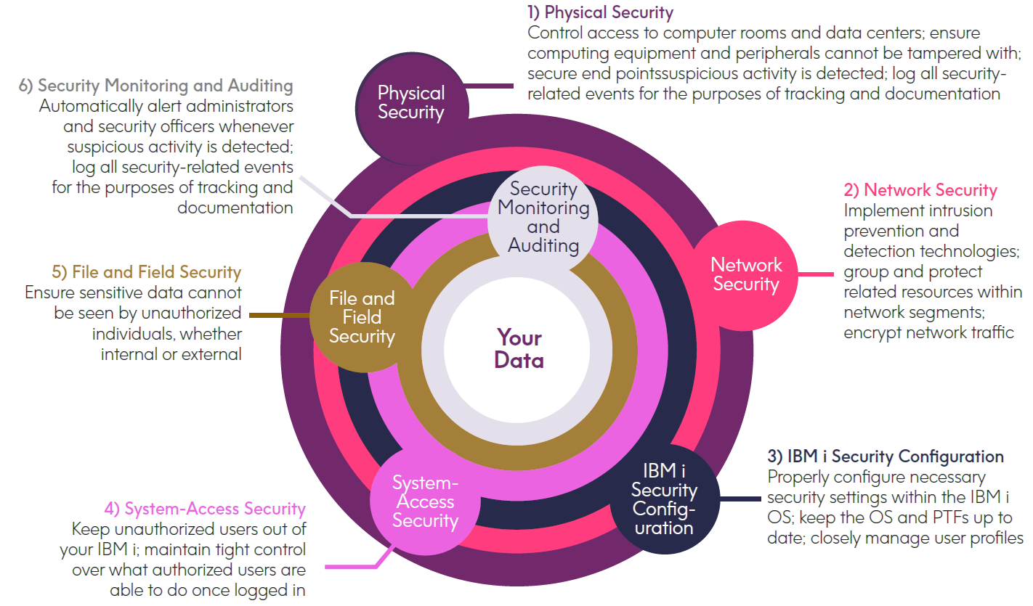
Layers of IBM i Security

Slide 89
Physical Security
More than just controlling access to computer rooms and data centers, a thorough physical security plan is required to protect the computing environment from theft, misuse, and intentional or accidental tampering.
Servers and storage devices: Lock into place all servers and storage devices, lock front-panel covers to prevent intentional or accidental changes, and secure power and other cabling to prevent easy disconnection.
Network devices: Lock into place physical firewalls, routers, switches, and other network devices; ensure power and other cabling can’t be easily disconnected; watch for unauthorized configuration changes to network equipment.
Peripheral devices: Keep within secure areas all printers and fax machines that output sensitive information.

Slide 90
Contd…
4. End-point devices — Educate employees on how to safely use desktops, laptops, and mobile devices, including taking care that these devices aren’t lost or stolen. If a device, however, is lost, stolen, or simply repurposed, IT staff needs the ability to locally or remotely execute a secure-wipe process. Of course, end-point devices need to be kept up to date with anti-virus, anti-malware, and anti-ransomware protection.

Slide 91
Network Security
The networks to which an IBM i is connected must be carefully secured, and if any of these networks are connected to the Internet, extra vigilance is required as Internet-connected networks often see thousands of access attempts each day by bots, sniffers, and hackers.
Firewalls — By examining the flow of data entering a network, firewalls prevent unauthorized traffic by allowing only network traffic that meets predefined firewall rules.
IDS and IPS - These technologies go beyond traditional firewall capabilities by analyzing traffic within the network itself for suspicious patterns of activity and then triggering alerts when such activity is detected. IPS goes a step further than IDS by acting to prevent the suspicious activity from affecting the network.

Slide 92
Contd…
3. Network segmentation — A network-security best practice is to avoid putting all IT assets together within a single network. By grouping together within each network only the systems and components that are related to one or more specific applications would be compromised.
4. Encryption of network data — Any data that is sent across a network must be encrypted to prevent passwords and other sensitive information from being read “in the clear.”

Slide 93
IBM i Security Configuration
Foundational to sound IBM i security is the proper configuration of the IBM i OS and related resources, as well as keeping OS versions and PTFs up to date.
System values settings: The QSECURITY system value that is used to specify the security level of the OS must be set to 40 or 50. Levels 40 and 50 also prevent direct access to objects, which means any user-written programs are required to utilize system interfaces (commands and APIs) in order to gain access to objects
IBM i server-configuration settings — review all IBM i servers and deactivate any that aren’t needed.
Controlling access to System Service Tools (SST) — special care should be taken when giving users SST access. Many SST capabilities provide significant access to data; for instance, network trace tools can provide a view of data flowing over a network. Because of this, care should be taken when giving users SST access.
User authority settings : A best practice that stops the spread of powerful profiles is to assign limited privileges to the majority of user profiles and then, on a case-by-case basis, temporarily grant selected users the authority they need to do a particular task. Third-party solutions make it easier for administrators, security officers, and end users to temporarily obtain elevated privileges as required. In addition, these third-party solutions log all actions taken once a user has the temporarily elevated authority.
Staying current on OS releases and PTFs : Running older releases of the IBM i OS can open a security risk within an enterprise.

Slide 94
System-Access Security
It helps keep unauthorized people out of IBM i environments while maintaining tight control over what authorized users are able to do once logged in.
Password management — Weak passwords and dormant user profiles pose a significant security vulnerability. Effective password management system is needed.
Multi-factor authentication - In instances where users need to access IBM i environments containing especially sensitive data, third-party technologies can be implemented that require two or more identifying factors from users before access is granted.
Network-access control — Unauthorized access via sockets and network protocols (e.g., ODBC, FTP, DRDA, etc.) can be prevented through the use of rules-based exit programs that cover network and socket exit points.

Slide 95
File and Field Security
Numerous regulations require companies in various industries to protect personally identifiable information (PII), personal health information (PHI), personal credit card information, and other sensitive data from being exposed. The following strategies and technologies are key to protecting files and data on the IBM i.
Object-level authority management: Sensitive file should be protected from public access. Through private authority, designated users can then be granted specific access to these files.
Row and Column Access Control (RCAC): prevent selected users from viewing specified rows in a file and/or data in particular columns.
File-access protection: Building upon object-level authority management, various exit points can be used with rules-based exit programs to further control access to files in very specific ways.
for instance, a particular file may only be accessed or a particular command may only be used during specific days or hours.

Slide 96
Contd…
Encryption: Convert the data into an unintelligible format using Encryption techniques. Encryption requires the careful management of encryption keys to ensure they don’t fall into the wrong hands.
Data at Rest: Third-party encryption solutions can encrypt sensitive data on the IBM i—such as credit card numbers—at the field level within databases. Technologies are also available that encrypt backup media and disk drives.
Data in motion: TLS 1.2 or greater must be used to encrypt application data sent across networks. In addition, when entire files containing sensitive information need to be sent between systems or entities via FTP, they should always be encrypted, both during transit and when transfer files reside within send/receive staging areas.
Date in use: Restrict access by user role, limiting system access to only those who need it.

Slide 97
Contd…
5. Tokenization of field data: An alternative method of shielding sensitive data within applications and on printouts is to replace this data with non-sensitive substitute values called tokens. Third-party tokenization solutions utilize a database called a token vault (residing on a different server) to store both the sensitive data and information about the relationship between it and its replacement token.
Tokenization is often used to replace credit card numbers, social security numbers, and other personally identifiable information.

Slide 98
Security Monitoring and Auditing
While all of the previous layers of security address prevention, this security layer focuses on implementing functions that log security-related events for the purposes of tracking, documentation, and to automatically alert administrators and security officers whenever suspicious activity is detected.
System-audit journaling: When properly activated and managed, the system-auditing functions provide the ability to monitor and track system, object, and security configuration changes.
File journaling: Another important aspect of auditing is the ability of file journaling to track and monitor any changes made to sensitive data stored in a file.
With file journaling activated, whenever users or applications make a change to data within the designated files, a journal entry is written to record the change.
The combination of system-audit journaling and file journaling can provide a complete audit trail of file-access and data-change activity

Slide 99
Contd…
3. Monitoring database-read activity: In situations where it is important for administrators and security officers to know if a user accessed and viewed particularly sensitive data— regardless if the data was changed—third-party technologies exist that can record these activities, complete with a snapshot showing the precise data the user viewed.
4. Analyze and report on journaled information and generate alerts: Once journaling is activated, it is important to have the ability to search for specific events, create reports, and set up alerts. Because information captured by journaling is recorded in a cryptic format, third-party solutions exist that make these important tasks significantly easier.
5. Save journaled data for compliance: All logged information from both the system-audit journal and file journaling is kept within objects called journal receivers, which must be regularly saved and archived in a secure location.
6. Forward journaled data to a SIEM solution: For companies that utilize a security information and event management (SIEM) solution, third-party tools are available that filter and format journaled data for integration with a SIEM.

Slide 100
Endpoint Security

Slide 101
Endpoint Security
An endpoint is any device that is physically an end point on a enterprise network. Endpoints serve as points of access to an enterprise network.
Laptops, desktops, mobile phones, tablets, servers, printer , scanners, medical and IoT devices can all be considered endpoints.
Endpoints are a popular attack vector, and the goal of an attacker is to not only compromise the endpoint but also to gain access to the network and the valuable assets within.
Endpoint security enables business to secure their endpoint devices (that employees use for work purposes ) on a network or in the cloud from malicious threats and cyber attacks.

Slide 102
Endpoint Security
Endpoint security plays a crucial role for businesses, ensuring critical systems, intellectual property, customer data, employees, and guests are protected from ransomware, phishing, malware, and other cyber attacks.
Without these endpoint protections in place, businesses could lose access to their valuable data, risking the very survival of their business. Repeat infections can also lead to costly downtime and the allocation of resources to remediating issues over critical business goals.
As the volume and sophistication of cybersecurity threats have steadily grown, so has the need for more advanced endpoint security solutions. Today’s endpoint protection systems are designed to quickly detect, analyze, block, and contain attacks in progress.

Slide 103
Why endpoint security is important?
In today’s business world, data is the most valuable asset of a company —and to lose that data, or access to that data, could put the entire business at risk.
Businesses have also had to deal with not only a growing number of endpoints, but also a rise in the number of types of endpoints.
An endpoint security strategy is essential because every remote endpoint can be the entry point for an attack, and the number of endpoints is only increasing with the rapid pandemic-related shift to remote work.
The attack surface is also becoming more complex: Hackers are constantly devising new methods to gain access, steal information, or compromise systems. It has been found Hackers launch a cyberattack every 39 seconds, with a daily total of 2,244 attacks.
So endpoint security plays a crucial role for businesses, ensuring critical systems, intellectual property, customer data, employees, and guests are protected from ransomware, phishing, malware, and other cyberattacks.

Slide 104
Benefits of Endpoint Security
Protecting all endpoints: As employees now connect via not only a growing number of endpoints but also different types of devices, it is vital for organizations to ensure they do so securely. They also need to ensure that the data on those devices is secure and cannot be lost or stolen.
Securing remote working: Every remote endpoint can be the entry point for an attack, and the number of endpoints is only increasing with new ways of getting work done, such as bring your own device (BYOD) and remote working policies.
Sophisticated threat protection: Hackers are constantly devising new ways of gaining access to corporate networks, stealing data, and manipulating employees into giving up sensitive information.

Slide 105
Different types of endpoint security solutions?
Endpoint protection Platform (EPP)
Endpoint Detection and Remediation (EDR)
Extended detection and response (XDR)

Slide 106
Endpoint protection Platform (EPP)
Endpoint protection provides essential security for many types of endpoints, from smart phones to printers.
An endpoint protection platform (EPP) includes multiple endpoint protection technologies integrated into the platform. So, EPP is an integrated suite of endpoint protection technologies—such as anti-malware signature scanning (antivirus), web browser security, credential theft monitoring, intrusion prevention, and data loss prevention—that detects and stops a variety of threats at the endpoint.
An endpoint protection platform provides a framework for data sharing between endpoint protection technologies.
This provides a more effective approach than a collection of siloed security products that lack the ability to communicate.
Endpoint protection platforms (EPP) work by examining files as they enter the network.

Slide 107
EPP versus individual endpoint products
There are multiple categories of endpoint security products. Some common ones include anti-malware, web browser security, mobile device security, embedded device security, and endpoint detection and response (EDR). These different products help to protect a variety of endpoints, including servers, desktops, laptops, smartphones, and embedded devices such as printers and routers.
The challenge of individual endpoint security products is the difficulty of managing them all effectively. IT departments often monitor multiple endpoint solutions. These individual applications all have different interfaces, requiring employees to switch between screens, decreasing effectiveness.
Siloed point products (i.e., individual endpoint products) also may not be able to exchange data, which wastes the opportunity for deeper analysis of security issues.
A more integrated and centralized approach to endpoint security is an endpoint protection platform (EPP). An EPP provides multiple endpoint security technologies and remediation capabilities in one place.

Slide 108
Endpoint Detection and Remediation (EDR)
Endpoint detection and response (EDR) is an integrated endpoint security solution that combines real-time continuous monitoring and collection of endpoint data with rules-based automated response and analysis capabilities.
Instead, it continuously monitors all files and applications that enter a device.
EDR solutions can also detect threats beyond just signature based attacks.
Fileless malware, ransomware, polymorphic attacks, and more can be detected using EDR solutions.

Slide 109
Endpoint Detection and Remediation (EDR)
The primary functions of an EDR security system are to:
Monitor and collect activity data from endpoints that could indicate a threat
Analyze this data to identify threat patterns
Automatically respond to identified threats to remove or contain them, and notify security personnel
Forensics and analysis tools to research identified threats and search for suspicious activities

Slide 110
Key components of EDR security
EDR security provides an integrated hub for the collection, correlation, and analysis of endpoint data, as well as for coordinating alerts and responses to immediate threats. EDR tools have three basic components:
Endpoint data collection agents. Software agents conduct endpoint monitoring and collect data—such as processes, connections, volume of activity, and data transfers—into a central database.
Automated response. Pre-configured rules in an EDR solution can recognize when incoming data indicates a known type of security breach and triggers an automatic response, such as to log off the end user or send an alert to a staff member.
Analysis and forensics. An endpoint detection and response system may incorporate both real-time analytics, for rapid diagnosis of threats that do not quite fit the pre-configured rules, and forensics tools for threat hunting or conducting a post-mortem analysis of an attack.

Slide 111
Extended detection and response (XDR)
Where EDR improved on malware detection over antivirus capabilities, XDR extends EDR's scope to include more deployed security solutions.
XDR has more capabilities than EDR.
It utilizes the latest and current technologies to provide higher visibility and collect and correlate threat information.
It employs analytics and automation to detect today's and future attacks.

Slide 112
How endpoint security works?
Endpoint protection solutions work by examining files, processes, and system activity for suspicious or malicious indicators.
Endpoint protection solutions offer a centralized management console from which administrators can connect to all the endpoints in their enterprise network. It helps administrator to control security for each endpoint device remotely.
This is achieved by leveraging either an on-premise, hybrid, or cloud approach.
The “Traditional or legacy” approach is often used to describe on-premise security posture that is dependent on a locally hosted data center from which security is delivered.
A “Cloud-native” solution built in and for the cloud. Administrators can remotely monitor and manage endpoints through a centralized management console that is hosted in the cloud and connects to devices remotely via an agent on the endpoint.

Slide 113
Endpoint security vs antivirus
Antivirus is one of the components of endpoint security. In comparison, endpoint security is a much wider (broader) concept including not just antivirus but many security tools (like Firewall, HIPS system, Allowlisting tools, Patching, and Logging/Monitoring tools, etc.,) for safeguarding the various endpoints of the enterprise (and the enterprise itself against these endpoints) and from different types of security threats.
More precisely, endpoints security employs a server/client model for protecting the various endpoints of the enterprise. The server would have a master instant of the security program, and the clients (endpoints) would have agents installed within them. These agents would communicate with the server the respective devices’ activities like the devices’ health, user authentication/authorization, etc., thus keeping the endpoints secure.
Whereas antivirus is usually a single program responsible for scanning, detecting, and removing viruses, malware, adware, spyware, ransomware, and other such malware. Simply put, antivirus is a one-stop shop for securing your home networks, and endpoint security are suitable for securing enterprises, which are larger and much more complex to handle.

Slide 114
Endpoint security vs Antivirus
Antivirus is often part of an endpoint security solution and is generally regarded as one of the more basic forms of endpoint protection.
Instead of using advanced techniques and practices, such as threat hunting and endpoint detection and response (EDR), antivirus simply finds and removes known viruses and other types of malware.
Traditional antivirus runs in the background, periodically scanning a device’s content for patterns that match a database of virus signatures. Antivirus is installed on individual devices inside and outside the firewall.

Slide 115
Core functionalities of an end point protection?
1: Prevention: NGAV
Traditional antivirus solutions detect less than half of all attacks. They function by comparing malicious signatures, or bits of code, to a database that is updated by contributors whenever a new malware signature is identified.
The problem is that malware that has not yet been identified, or unknown malware, is not in the database. There is a gap between the time a piece of malware is released into the world and the time it becomes identifiable by traditional antivirus solutions.
Next-generation antivirus (NGAV) closes that gap by using more advanced technologies, such as AI and machine learning, to identify new malware by examining more elements, such as file hashes, URLs, and IP addresses.

Slide 116
Core functionalities of an end point protection?
2: Detection: EDR
Prevention is not enough. No defenses are perfect, and some attacks will always make it through defenses and successfully penetrate the network.
To prevent silent failures, an Endpoint Detection and Response (EDR) solution needs to provide continuous and comprehensive visibility into what is happening on endpoints in real time.
Businesses should look for solutions that offer advanced threat detection and investigation and response capabilities.

Slide 117
Core functionalities of an end point protection?
3: Managed Threat Handing
Not all attacks can be detected by automation alone.
The expertise of security professionals is essential to detect today’s sophisticated attacks.
Managed threat hunting is conducted by elite teams that learn from incidents that have already occurred, aggregate crowdsourced data, and provide guidance on how best to respond when malicious activity is detected.

Slide 118
Core functionalities of an end point protection?
3: Managed Threat Handing
Not all attacks can be detected by automation alone.
The expertise of security professionals is essential to detect today’s sophisticated attacks.
Managed threat hunting is conducted by elite teams that learn from incidents that have already occurred, aggregate crowdsourced data, and provide guidance on how best to respond when malicious activity is detected.

Slide 119
Core functionalities of an end point protection?
4. Threat Intelligence Integration
Threat intelligence is knowledge that allows you to prevent or mitigate more sophisticated and advanced cyber attacks. Rooted in data, threat intelligence provides context — like who is attacking you, what their motivation and capabilities are, and what indicators of compromise in your systems to look for — that helps you make informed decisions about your security.
A threat intelligence integration solution should incorporate automation to investigate all incidents and gain knowledge in minutes, not hours.
It should generate custom indicators of compromise (IoCs) directly from the endpoints to enable a proactive defense against future attacks.

Slide 120
Extra Information

Slide 121
Some important terms
Data loss prevention (DLP), which stops end users from sharing sensitive content outside of the organization
Fileless malware is a type of malicious software that uses legitimate programs to infect a computer. It does not rely on files and leaves no footprint, making it challenging to detect and remove.
Antivirus software helps businesses detect, eliminate, and prevent malware from infecting devices
Indicators of compromise (IOCs) refer to data that indicates a system may have been infiltrated by a cyber threat.
The intelligence lifecycle is a process to transform raw data into finished intelligence for decision making and action
https://www.crowdstrike.com/cybersecurity-101/threat-intelligence/

Slide 122
Threat Inteligence
Threat intelligence is data that is collected, processed, and analyzed to understand a threat actor’s motives, targets, and attack behaviors. Threat intelligence enables us to make faster, more informed, data-backed security decisions and change their behavior from reactive to proactive in the fight against threat actors.
Threat intelligence delivers in-depth information such as URLs, domain names, files, and IP addresses that were used to execute attacks. The information helps an organization defend itself from current attacks and respond to security incidents
Requirement:
who the attackers are and their motivations
what is the attack surface
what specific actions should be taken to strengthen their defenses against a future attack
Collection
Processing
Analysis
Dissemination
Feedback

Slide 123
Threat intelligence, also known as cyber threat intelligence (CTI), is information gathered from a range of sources about current or potential attacks against an organization.

Slide 124
Some important terms
Data loss prevention (DLP), which stops end users from sharing sensitive content outside of the organization
Fileless malware is a type of malicious software that uses legitimate programs to infect a computer. It does not rely on files and leaves no footprint, making it challenging to detect and remove.
Antivirus software helps businesses detect, eliminate, and prevent malware from infecting devices

Slide 125
End of Module-2

